Slide 1
HealthNet
Grewp2
Kyler
Nicholas
Smruthi
Umang

Slide 2
The Team
Nicholas Deyette: Configuration/QA Coordinator
Kyler Freas: Team Coordinator
Smruthi Gadenkanahalli: Design and Development
Umang Garg: Requirements Coordinator

Slide 3
Description
Introduction
HealthNet is a Hospital Administration application.
HealthNet enables Hospitals to manage their employees and patients
The HealthNet is intended to improve hospitals by providing an easy mechanism for managing employees, gathering statistical data on the inner workings of the hospital, signing up patients, making appointments, and allowing ease of transfer of both patients and their information between hospitals.
It enables the patients to Register and Login to book and update an appointments with the doctors.

Slide 4
Objectives
Finalize requirements for Release
Prepare Use Cases
Design Software Architecture,Class Model,and System Sequence Diagrams
Build the application for requirements finalized for Release 1

Slide 5
Release 1
Patient Registration and Login
Update Patient Profile
Create and update Appointment
Cancel Appointment
Appointment Calendar
Log activity to system
View logs

Slide 6
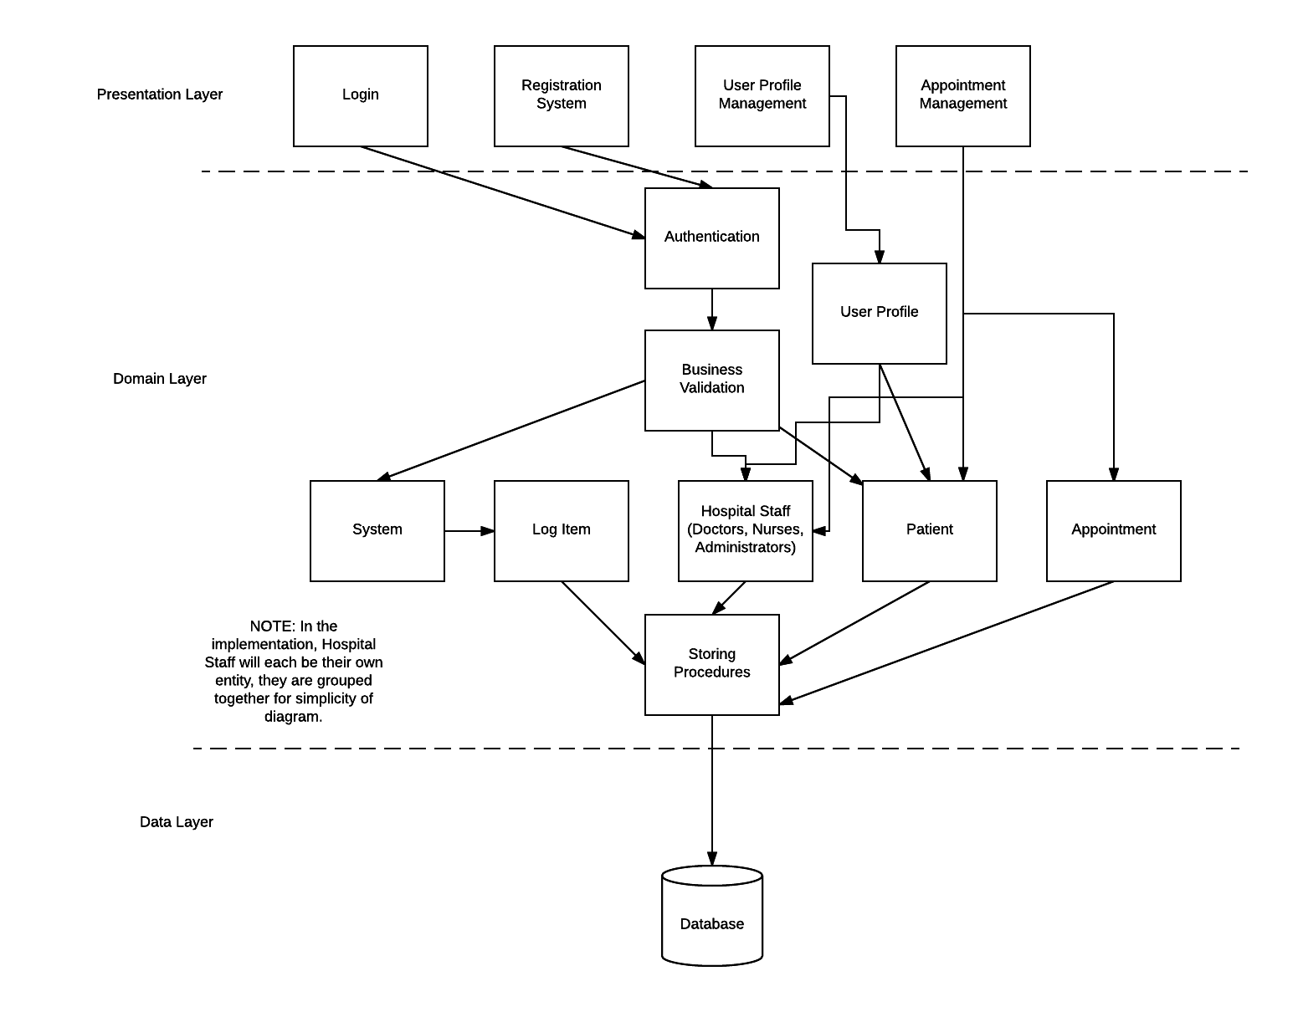
Application Architecture
Describes the high level structure of the application components and their associations

Slide 7
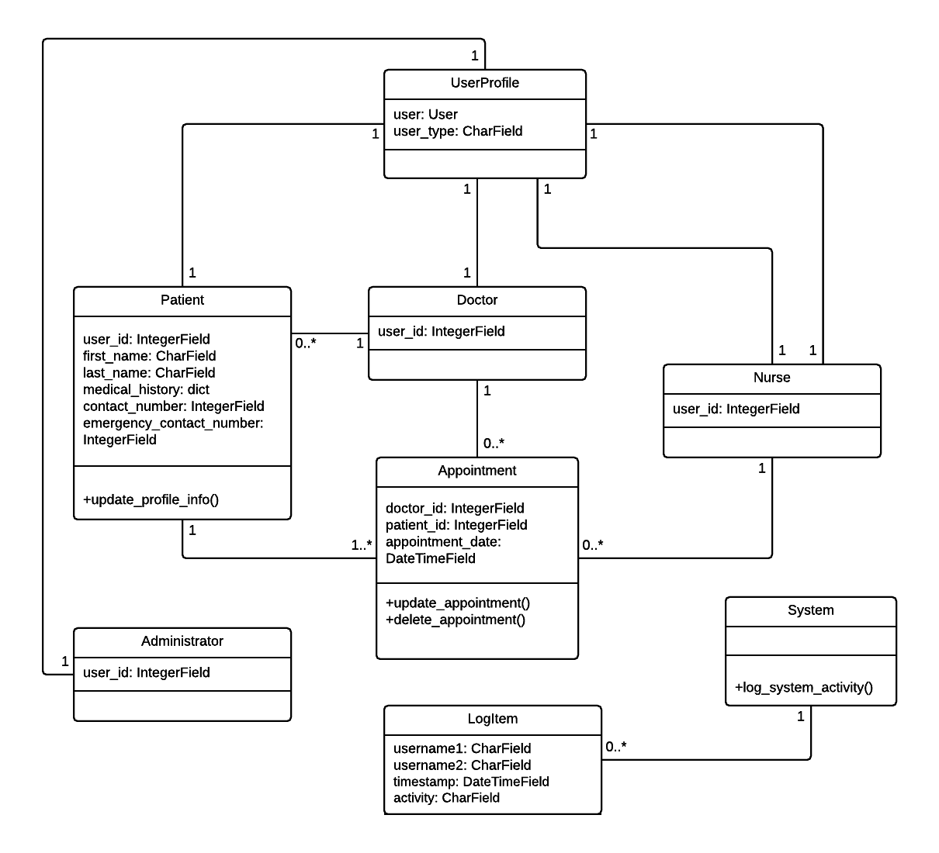
Class Diagram
Classes include
User Profile
Patient
Doctor
Nurse
Appointment
System
Administrator
Log Item

Slide 8
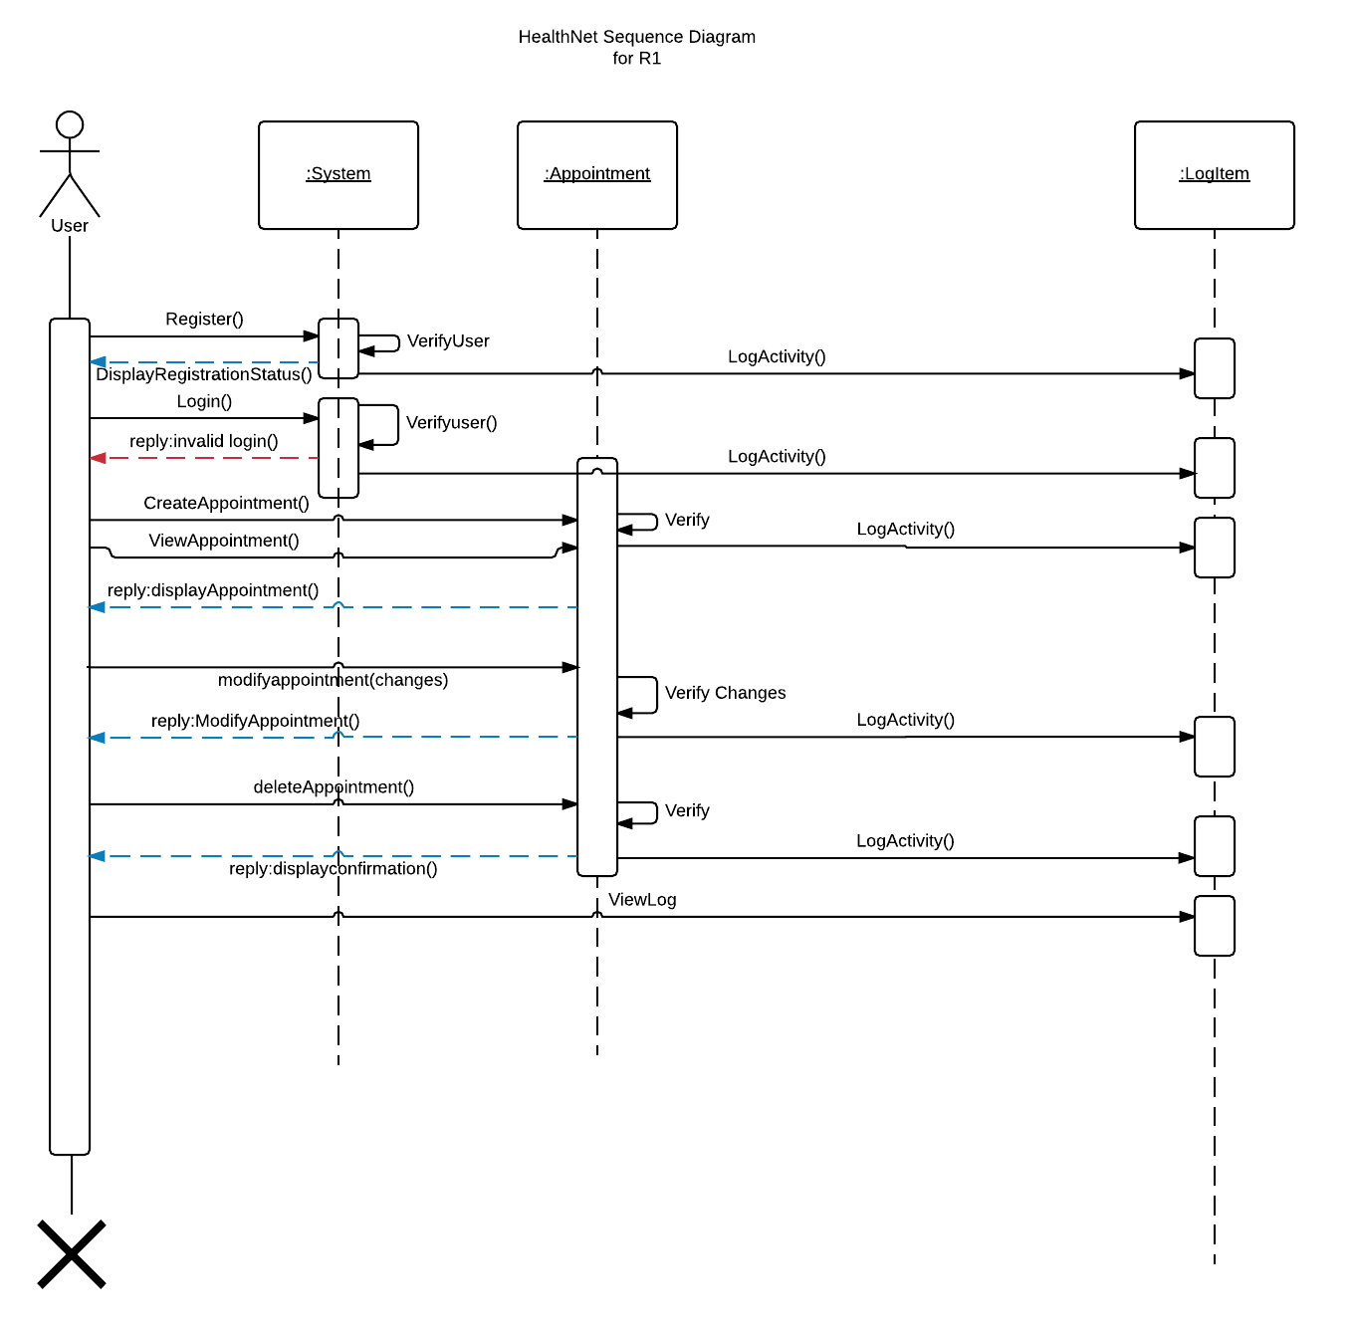
Sequence Diagram
Describes the sequence of events occurring during the application execution

Slide 9
Implementation
Process Model
Agile Development Model
Incremental release
Development Environment
Python 3.4.3
SQLite version 3.8.0.2
Django 1.9.1
PyCharm 2016.2.1

Slide 10
Testing
Unit testing for all the Models
Integration Testing using the Test Planner Tracker

